Slide 1
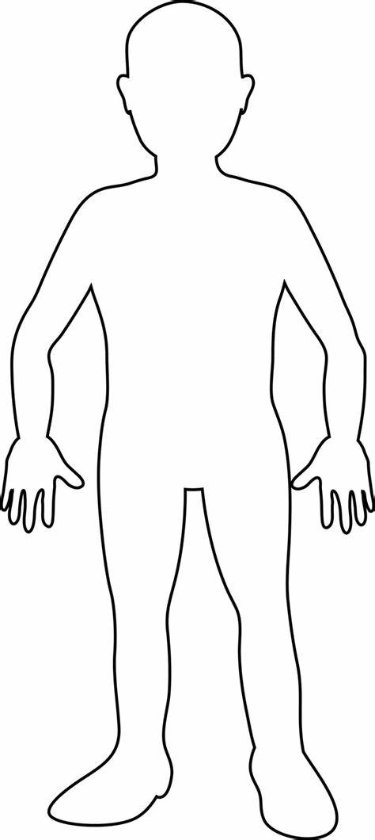

Slide 3
Angry

Slide 5
Scared

Slide 7
Sad

Slide 9
Hungry

Slide 11
Grumpy

Slide 13
Peaceful

Slide 15
Loving

Slide 17
Worried

Slide 19
Nervous
Excited

Slide 21
Proud

